Slide 1

[Samsung PRISM] End Review Report
IPFS Helia based Decentralized Storage Integration for DApps Ecosystem
Team
College Professor(s):
1. Sakthivel V / sakthivel.v@vit.ac.in
2. Karthika V / vkarthikatnj@gmail.com
2. Students:
Jeya Madhavan S S / jeyamadhavan.ss2022@vitstudent.ac.in
Mrithulasree N / mrithulasree.n2022@vitstudent.ac.in
Dinesh R / dinesh.r2022@vitstudent.ac.in
Pranay Singanalli / pranay.singanalli2022@vitstudent.ac.in
Harshitha Yenigalla / harshitha.y2022@vitstudent.ac.in
3. Department: Cse core & ECM
Date: 5 Feb 2025

Slide 2


Work-let Area – Web3 | IPFS Helia based Decentralized Storage Integration for DApps Ecosystem
Problem Statement
Web 3.0 describes the next evolution of the World Wide Web, the user interface that provides access to documents, applications and multimedia on the internet.
Web3 will place a strong emphasis on decentralized applications (dApps) and make extensive use of blockchain-based technologies.
Web3 data storage refers to the management and storage of data associated the dApps. It utilizes technologies like InterPlanetary File System (IPFS) and on-chain storage.
Each user has their own node which can communicate with others in the network, enabling seamless file storage and retrieval. By harnessing the power of IPFS, Web3 offers a decentralized approach to data storage that ensures privacy, security, and improved accessibility for users.
This worklet provides an opportunity to explore and integrate IPFS Helia based Decentralized Storage for Dapps Ecosystem.
Implementation:
IPFS Helia based decentralized storage for storing any content (like media files).
Development of DApp front end for content search and consumption.
Create NFTs for newly created media files, on Blockchain testnet like Sepolia
Rewards/Incentives through Smart Contracts, for the asset owner when their content is consumed by other nodes.
Work-let expected duration – 4 months
Expectations
Decentralized Storage for storing media which are uploaded through Dapp’s front end.
Explore JS based decentralized storage mechanisms like IPFS Helia and use the same for integration.
DApp Front End based on ReactJS or Bootstrap
Design UI for uploading media (to store on Decentralized IPFS storage), creating NFTs for the same on the blockchain testnet (eg. Sepolia)
Options to search, find and consume the content which are available on the connected blockchain network.
Crypto wallet required for cryptocurrency transactions done by Users(Nodes) through backend Sepolia Testnet.
Wallets like Metamask, Coinbase should be used to connect to backend Sepolia Testnet for ETH currency required for transactions, rewards etc.
Showcase the Demo with at least two Users(Nodes) participating on the blockchain testnet
Eg. UserA from one node(machine) creates NFTs and uploads media files on IPFS storage. UserB being another node looks for available media through front end DApp, and consumes the resource (the media has to be streamed successfully).
Based on the Smart Contracts, UserA will be rewarded/credited with some percentage of ETH for UserB consuming UserA’s media, by deducting currency from the UserB’s Crypto-wallet.
Training/ Pre-requisites
Good Knowledge on Web3 concepts and terminologies (Blockchain, SmartContracts, etc.)
JS frameworks like ReactJS/Bootstrap, NodeJS etc. for front end and backend development respectively.
Knowledge on Crytowallet and Ethereum testnets like Sepolia.
Understanding of IPFS decentralized storage mechanisms.
3
Members
Mentor 1:
Gajendra N
gajendra.n@samsung.com
Additional Documentation:
Kick Off < 1st Month >
Understanding of how Web3 works.
Hands on JS libraries like ReactJS, NodeJS etc.
Explore any existing Web3 project from Github.
Milestone 1 < 2nd Month >
DApp front end development.
Functionalities for creating NFTs , uploading media files and IPFS storage. implementation.
Milestone 2 <3rd Month >
Connecting front end to back end testnet sepolia, through Wallets.
Logic for Reward/Incentives to owners, through Smart Contracts.
Closure < 4th Month >
Stabilizing the implementation of aforementioned features.
Preparing for the final demonstration.

Slide 3
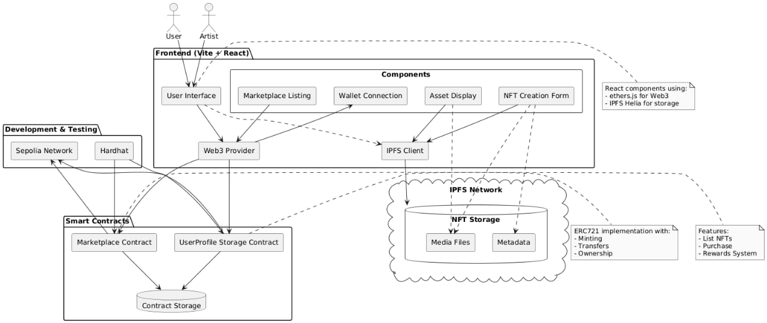
Approach / Solution
Concept Diagram :
( Clear detailed schematic / block diagram / flow chart depicting the proposed concept / solution )

Slide 4
Dataset(s) Analysis / Description
Dataset Capture / Preparation / Generation :
(Discuss the dataset generation process or if downloaded data provide details of what data & from where it was obtained etc… - 2 to 3 bullets only)
N/A
Dataset Understanding / Analysis :
(Provide 2 to 3 bullets about what is your understanding of the data / opinion about the data)
N/A
Dataset Pre-Processing / Related Challenges (if any) :
(List out the challenges you fore see in data handling wrt problem definition – 2 to 3 bullets only)
N/A

Slide 5
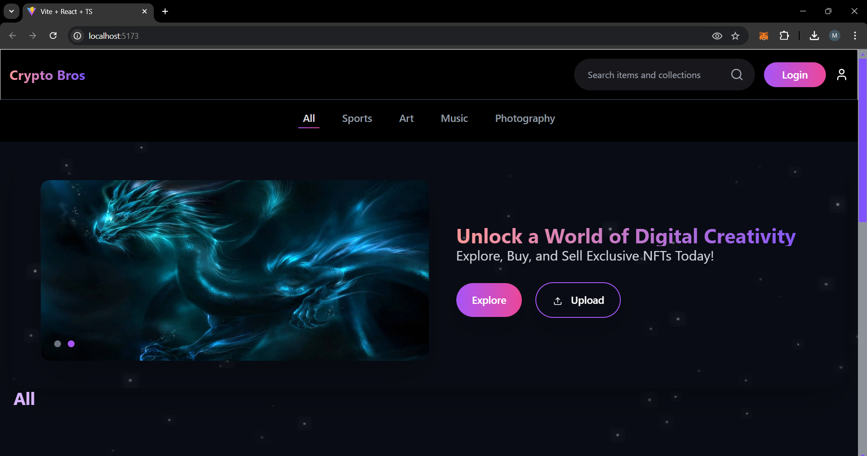
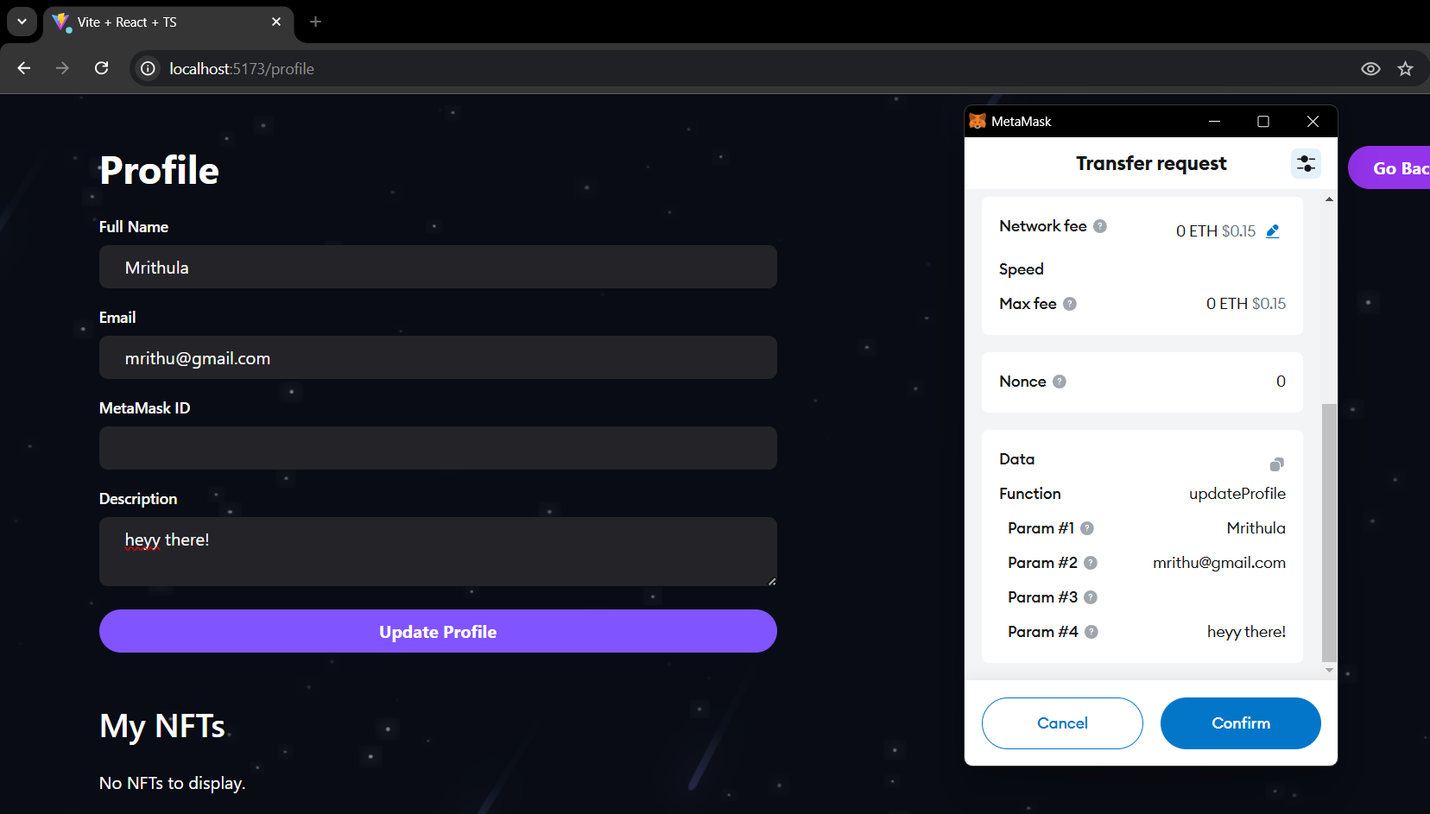
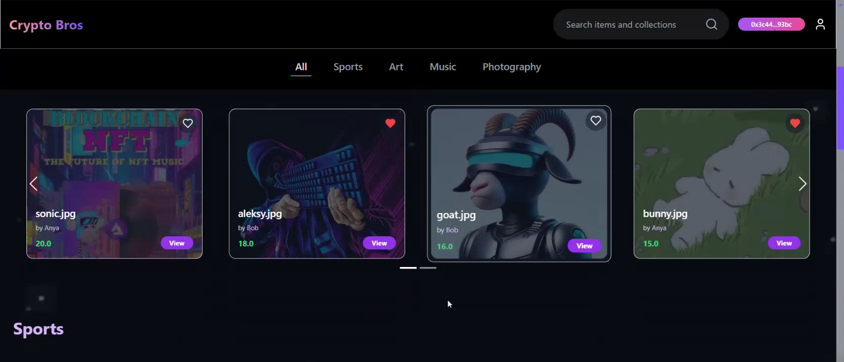
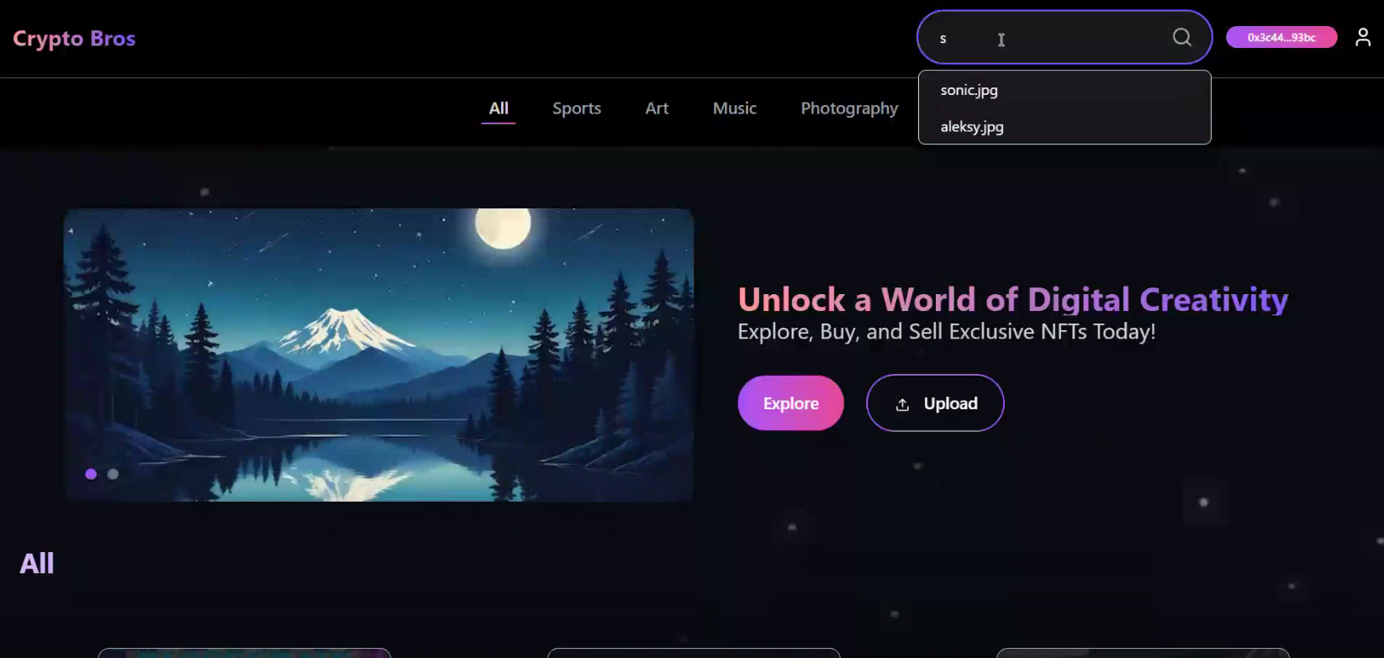
Experimental Results / Simulations / Observations
Results :
(provide numerical data / bar charts / plots / images / videos / tabulated results etc. Use full slide or multiple slides up to max 3 slides to demonstrate the results)
Frontend UI components- Login
Profile updation
Frontend progress
Search functionality

Slide 6
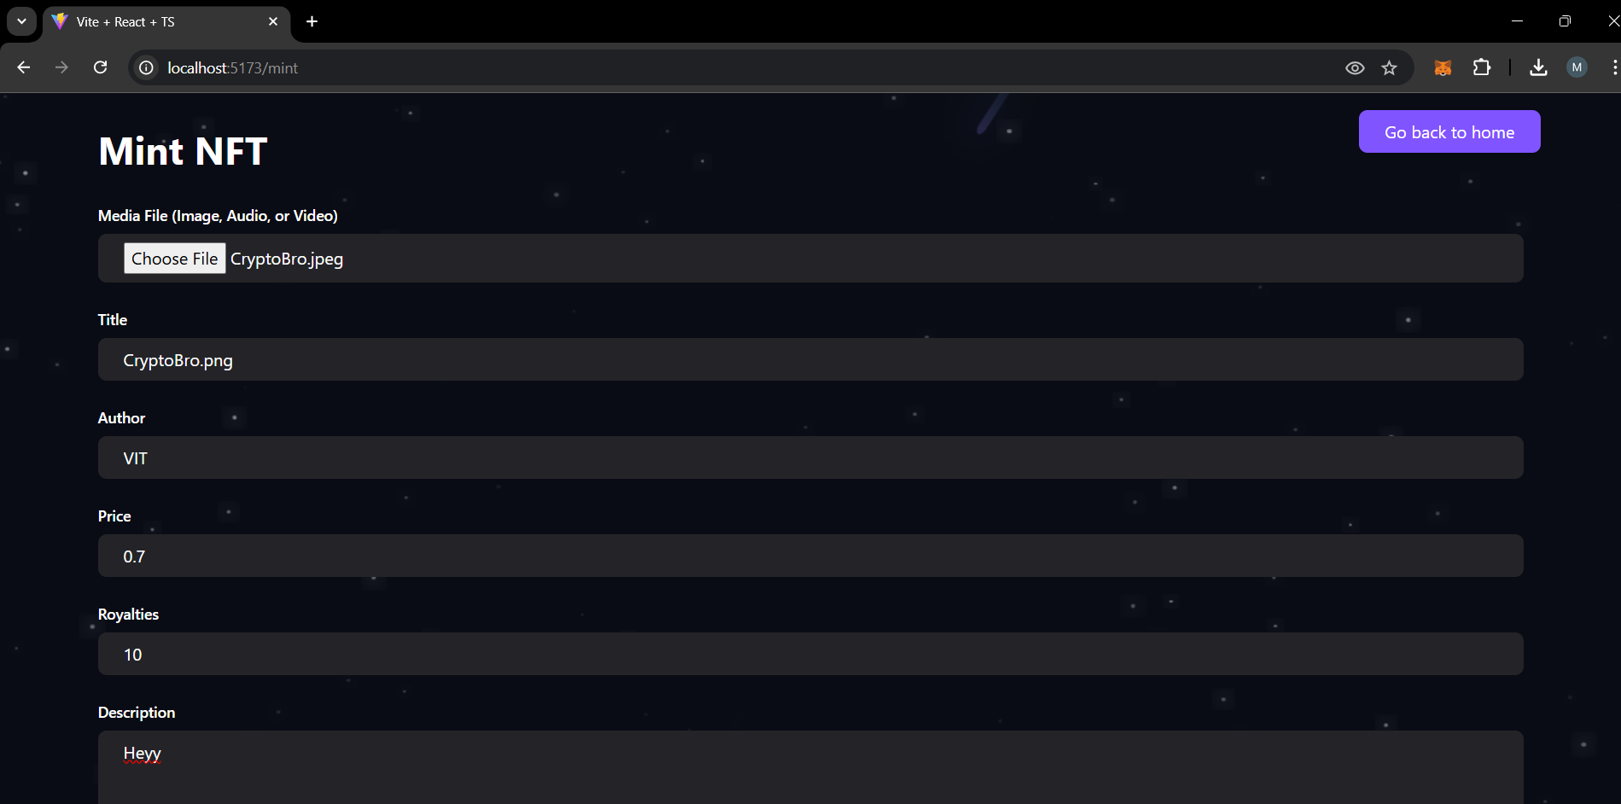
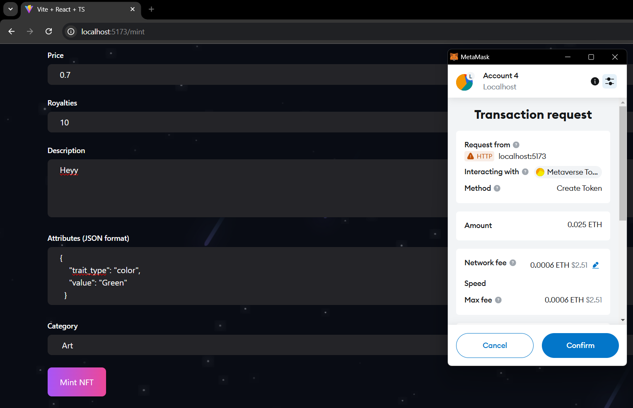
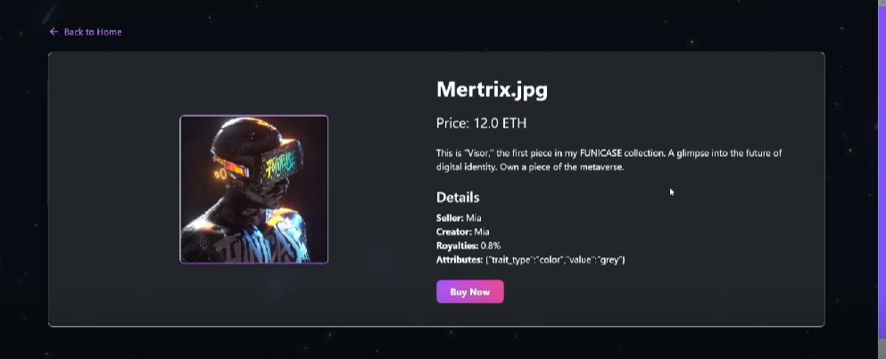
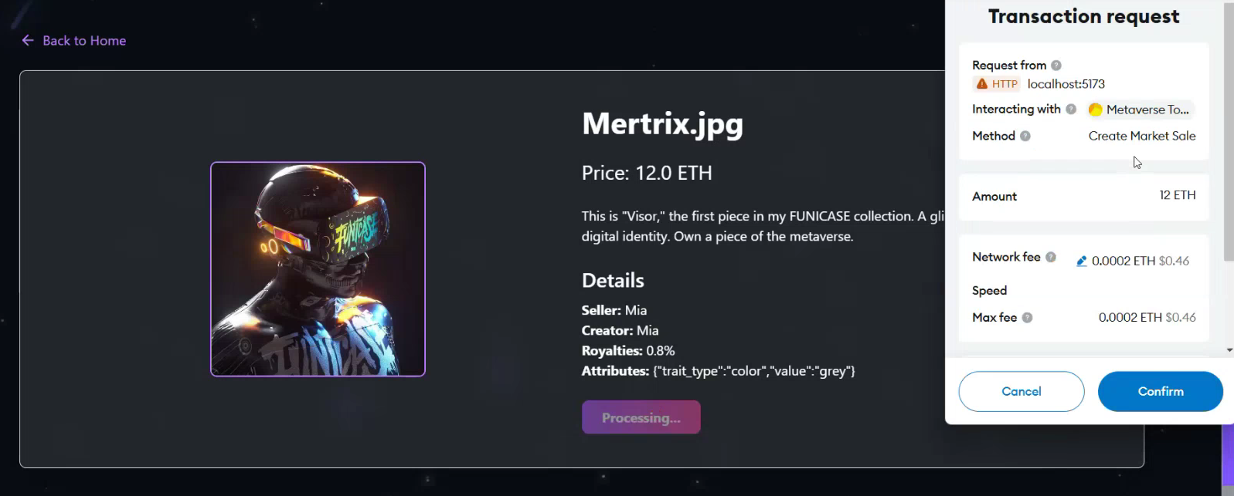
Experimental Results / Simulations / Observations
Results :
(provide numerical data / bar charts / plots / images / videos / tabulated results etc. Use full slide or multiple slides up to max 3 slides to demonstrate the results)
Minting an NFT
Minting an NFT( transaction process)
NFT Detail Page
Transaction process

Slide 7
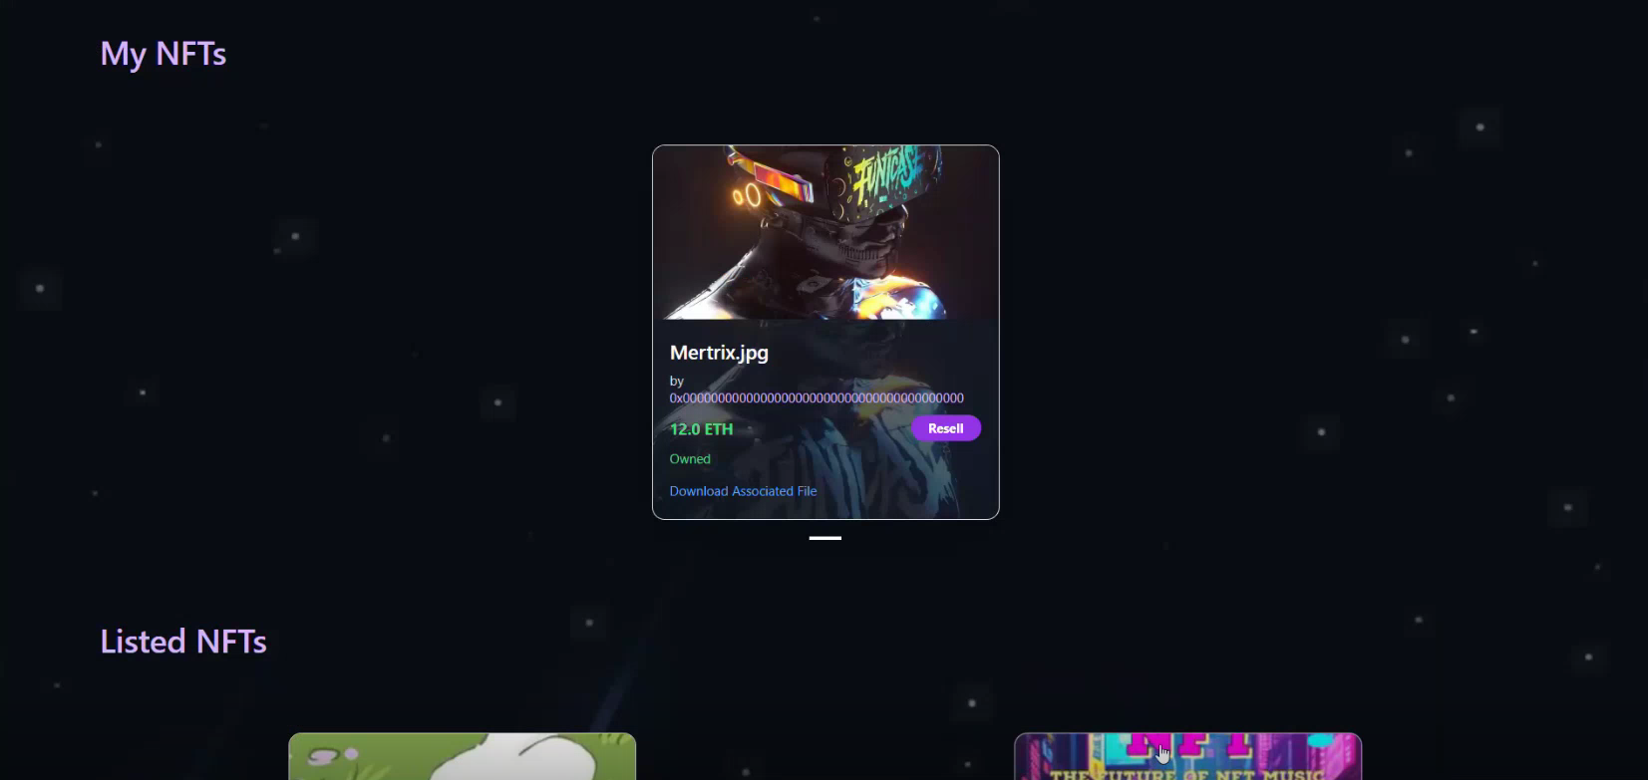
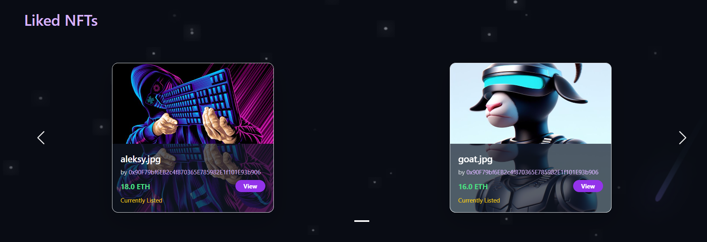
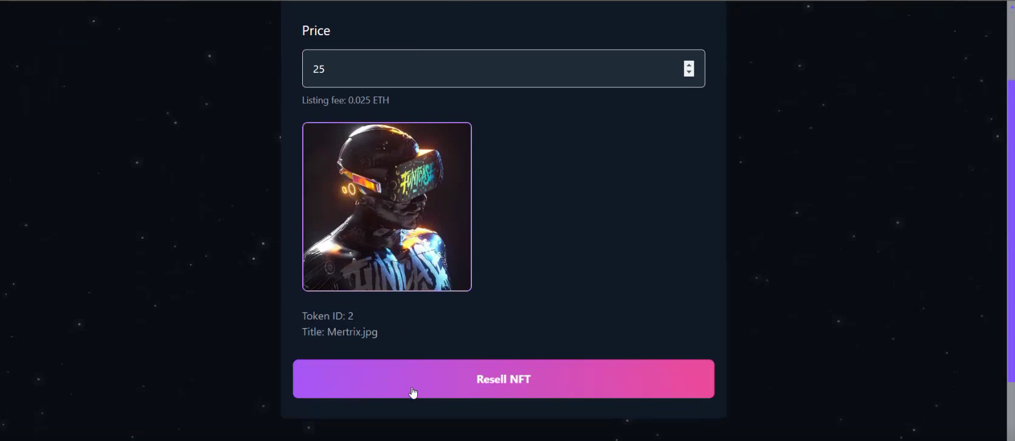
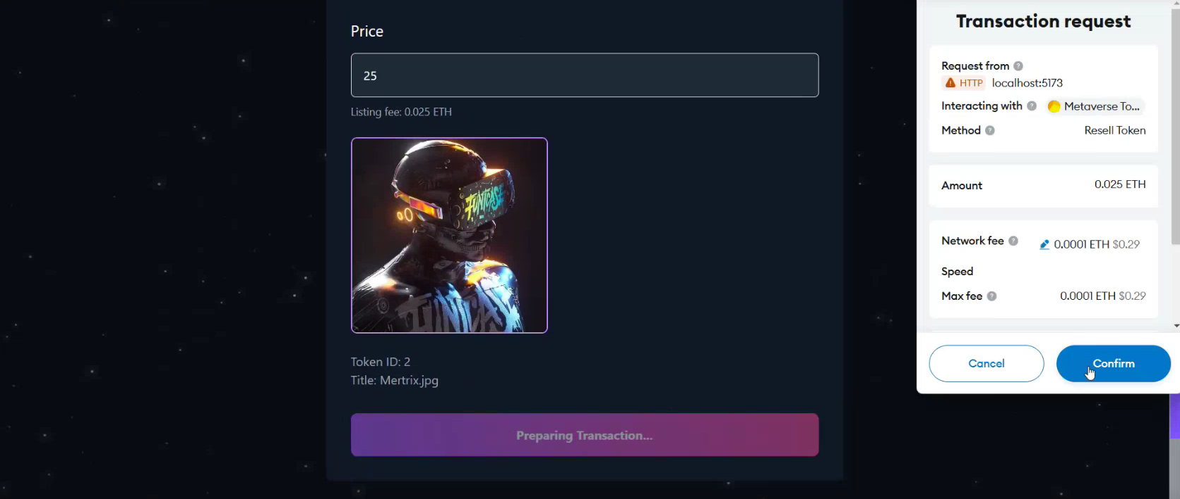
Experimental Results / Simulations / Observations
Results :
(provide numerical data / bar charts / plots / images / videos / tabulated results etc. Use full slide or multiple slides up to max 3 slides to demonstrate the results)
User Profile ( My NFTs, Listed NFTs )
User Profile ( Liked NFT )
Resell NFT
Resell NFT ( Transaction process )

Slide 8
Experimental Results / Simulations / Observations
Conclusions:
Frontend Development Milestones
Implemented key marketplace features: NFT Upload & Minting Page, NFT Details Page, Liked NFTs Gallery, Resell NFT, and Profile Page.
MetaMask wallet for seamless transactions and user authentication.
Smart Contract Development
Developed an ERC721-based NFT smart contract with OpenZeppelin standards.
Implemented marketplace functions like createMarketItem, createMarketSale, and resellToken for buying, selling, and relisting NFTs.
Integrated ERC2981 for automated royalty payments to original NFT creators upon resale.
Created UserProfileStorage smart contract to manage user profiles securely on-chain.
IPFS Integration Progress
Utilized IPFS for decentralized storage of NFT metadata and media files.
Implemented Helia node for uploading NFT files to IPFS and retrieving stored data.
Functionality
Successfully implemented search functionality to improve NFT discoverability.
Optimized gas fees by storing liked NFTs off-chain using MongoDB.
Integrated query functions (fetchMarketItems, fetchMyNFTs, fetchItemsListed) for efficient marketplace navigation.
Testing & Validation
Successfully tested contract deployments on Hardhat local network and Sepolia testnet.
Validated API endpoints and ensured smooth NFT minting, buying, and selling processes.
Verified correct royalty distribution by tracking wallet balances before and after transactions.
Configured Hardhat with Etherscan API and Alchemy RPC for contract deployment and verification.

Slide 9
Experimental Results / Simulations / Observations
Challenges :
IPFS Integration Complexities – Managing file uploads and metadata handling on IPFS required proper synchronization to ensure seamless retrieval and display of NFT data.
Gas Fee Optimization – Storing liked NFTs on-chain was impractical due to high gas costs, leading to an off-chain MongoDB solution for efficient state management.
Testing Environment Setup & Configuration – Setting up Hardhat, Etherscan API, and Alchemy RPC for contract deployment and verification required debugging and proper configuration.
Frontend-Backend Integration – Synchronizing smart contract functions with the React-based frontend using Ether.js to ensure real-time transaction updates and smooth UI interaction.
State Management Across React Components – Implementing real-time updates across different components for NFT listings, purchases, and profile changes while maintaining performance efficiency.
Royalty Distribution & Transaction Flow Verification – Ensuring correct royalty payments to creators by tracking wallet balances before and after transactions while handling marketplace fee deductions.

Slide 10
Deliverable
Final Deliverables :
(Discuss in the form of bullets, what are the next steps to complete the solution, any road blocks / bottlenecks, any support needed from SRIB)
N/A
IP / Paper Publication Plan :
(Details of papers / patentable ideas / innovative aspects that can lead to patentable ideas)
KPIs delivered/Expectations Met:
(Planned Expectations shared in Work-let vs Delivered Results)
Successfully built interactive DApp frontend with MetaMask wallet integration
Set up IPFS with Helia for file storage, completed smart contract testing on Sepolia, validated APIs, and used MongoDB for storing liked NFTs off-chain.
Successfully implemented NFT buying, selling, minting along with content search and royalty distribution.

Slide 11
Thank you

